Slide 1
Predicting Energy Prices Using a Multimodal Machine Learning Approach
Jad Akra
EECE690 – Intro to Machine Learning

Slide 2
Content
Energy Trading and Energy Prices
Data Overview and Assumptions
Unimodal Approach
Additional Data
Multimodal Approach
Results and Comparison

Slide 3
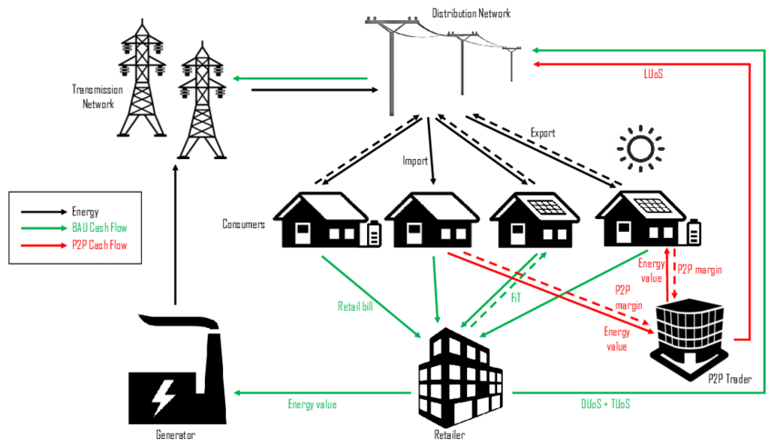
Energy Trading and Energy Prices
💡 What is Energy Trading?
⚖️ Why It's Crucial?
🌍 Types of Markets:
Day-Ahead Market: Contracts for energy to be delivered the next day.
Intraday Market: Adjustments made closer to real-time.
Futures Market: Long-term contracts and hedging

Slide 4

Data Overview and Assumptions
Price (EUR/MWhe)
Load Demand
Solar Generation
Wind Generation
Gas Prices
Oil Prices
Temperature
Irradiation

Slide 5
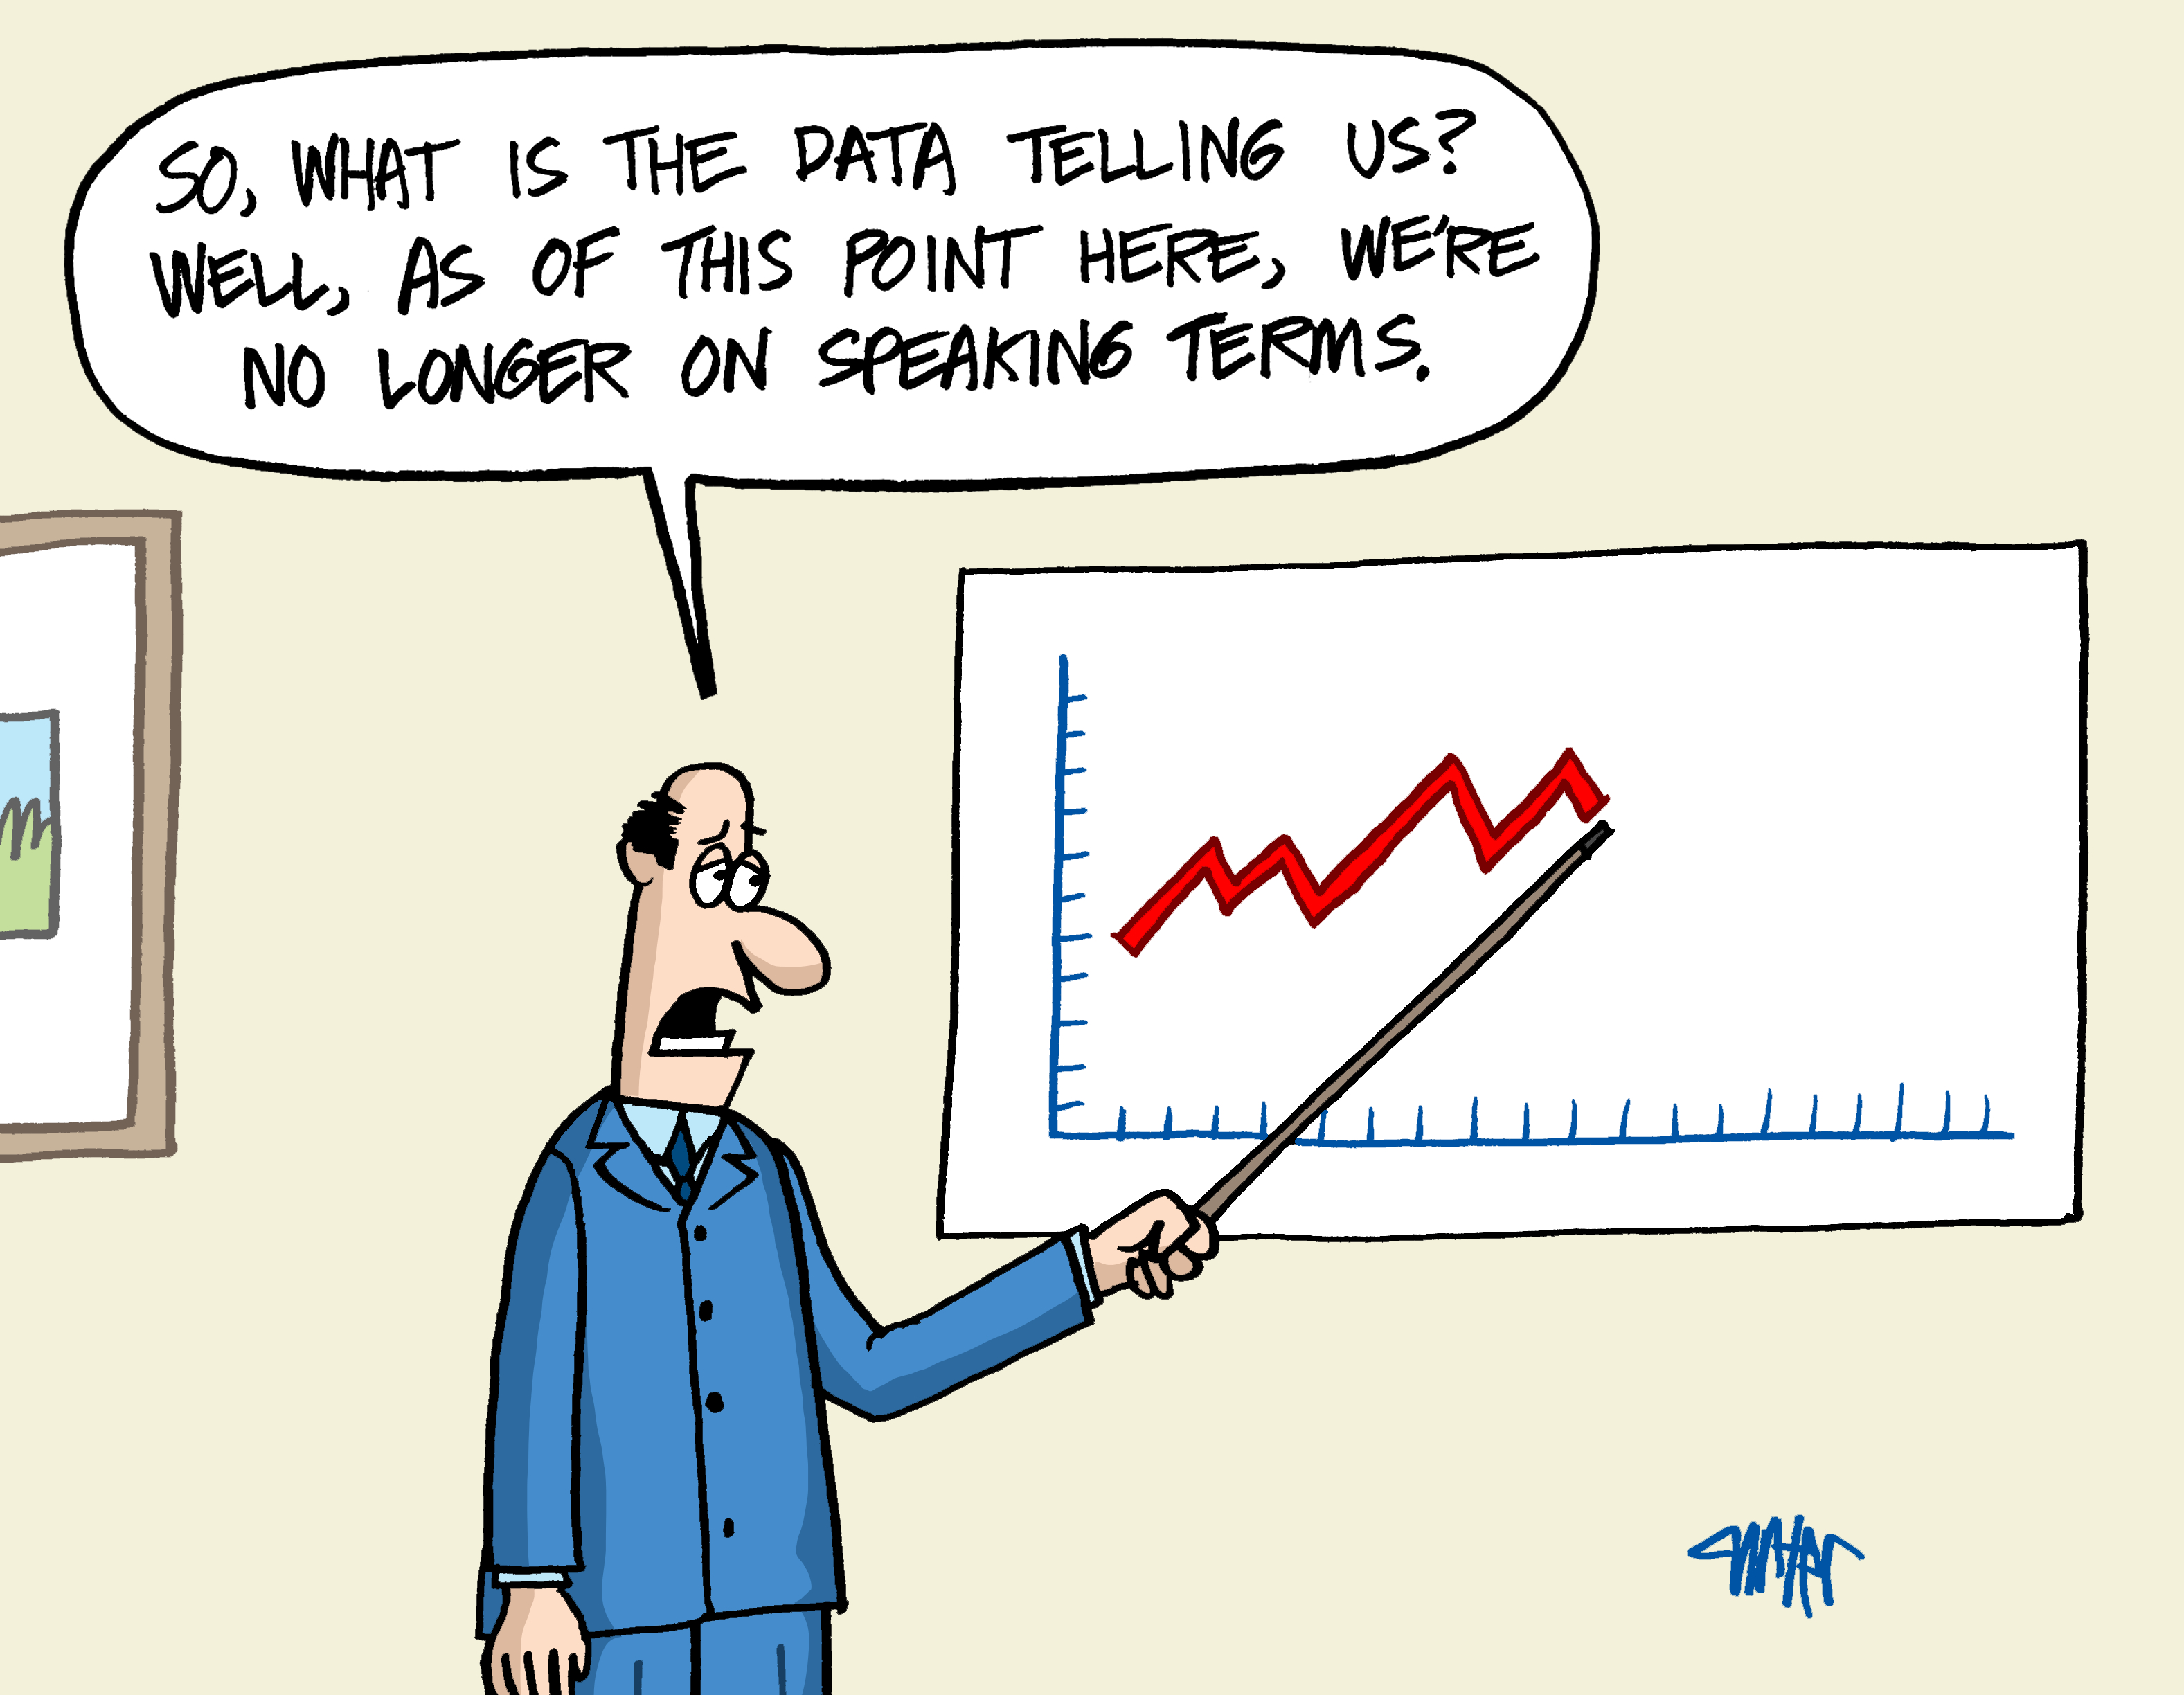
Unimodal Approach: Features
🏗️ Model Inputs:
Historical Prices:
Lagged prices at T−1h, T−24h, T−168h
Rolling averages: 24h, 168h
Generation & Load:
Solar, wind generation (actual)
Total load (actual)
Fuel Prices:
Oil & gas prices
Weather Features:
Temperature
Solar radiation (direct & diffuse)
Calendar Features:
Hour of day, day of week, month
Derived Ratios:
Solar/Load, Wind/Load

Slide 6
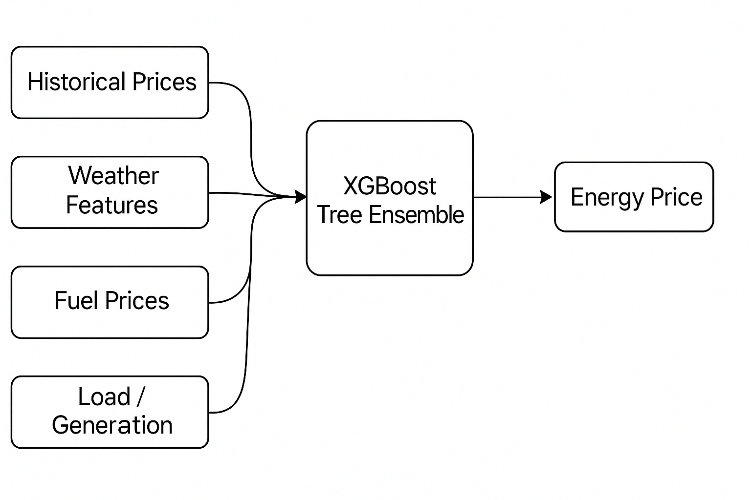
Unimodal Approach: XGBoost
Boosting Concept
Builds an ensemble of weak learners (typically decision trees)
Each new tree focuses on correcting the errors of the previous trees
Final prediction is a weighted sum of all tree outputs
2. Objective Function
Optimizes a loss function (like Mean Squared Error) using gradient descent
Adds regularization to prevent overfitting (e.g., tree depth, number of leaves)
3. Tree Construction
Greedy algorithm splits data at points that reduce loss the most
Automatically handles feature interactions & nonlinearity

Slide 7
Unimodal Approach: Results
Prediction | hours | 24 | 48 | 72 | 168 | 336 | 672
Base Model | MAE | 6.07 | 6.47 | 6.85 | 6.33 | 6.64 | 6.28
 | RMSE | 8.79 | 9.45 | 9.78 | 8.92 | 9.49 | 8.93

Slide 8



Additional Data: News
Why News?
Reflects market shocks, geopolitical tension, regulation changes.
Adds a human-context layer often missed in structured datasets.
News Sources Used:

Slide 9
Additional Data: News
Categories Filtered:
Politics, Markets, Europe, Oil Markets, Middle East, Commentary, etc.
Based on correlation with price volatility and energy events.
Preprocessing:
Filtered 2015–2019 news to energy-relevant categories.
Cleaned and parsed timestamps → Hourly alignment with energy dataset.
Applied BERT-based sentiment analysis to compute:
Average Sentiment Score
Positive Sentiment Ratio

Slide 10
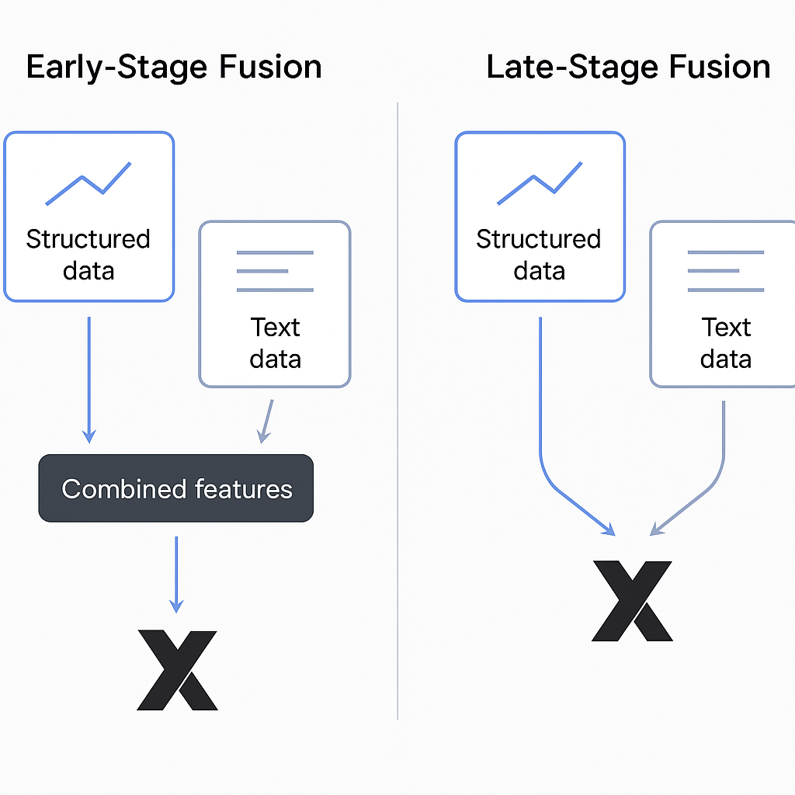
Multimodal Approach
Fusion Strategy: Early-Stage Fusion
Modality | Data Type | Features Used
Structured | Numerical / Time Series | Load, generation, fuel prices, temperature
Unstructured | Text (converted to numeric) | Sentiment scores (avg, lag, rolling)

Slide 11
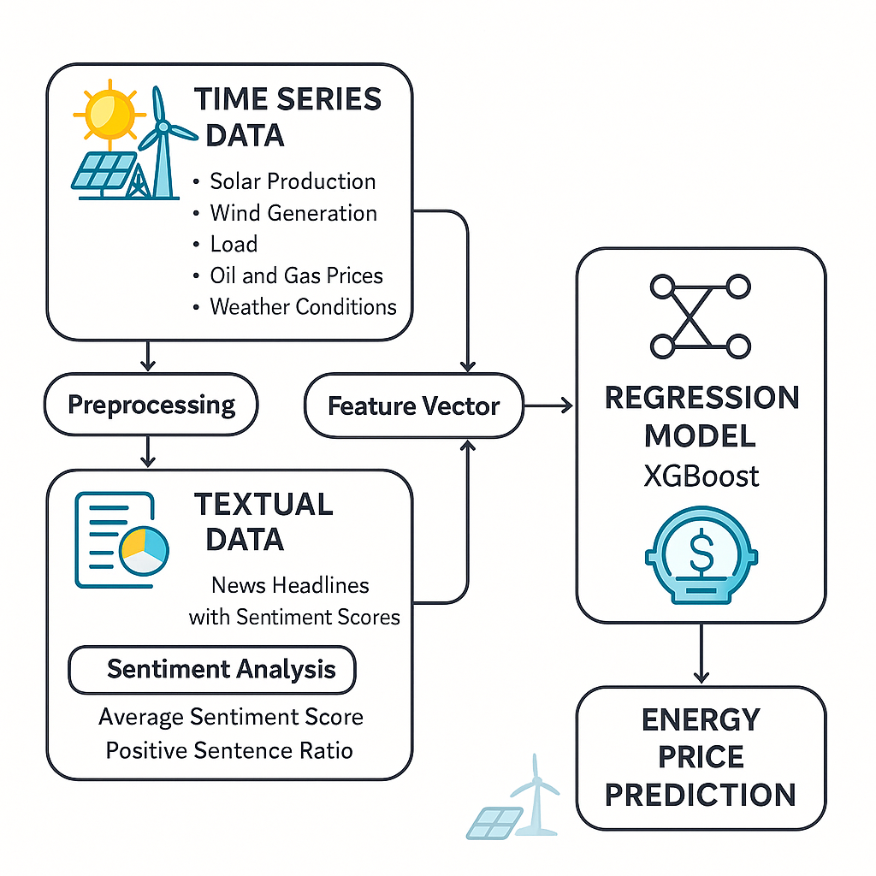
Multimodal Approach: Implementation
Aligned hourly sentiment scores with energy records.
Concatenated sentiment-derived features (e.g. avg_score_lag_24h) with traditional energy predictors.
Fed combined feature matrix into XGBoost.

Slide 12
Results and Comparison
Prediction | hours | 24 | 48 | 72 | 168 | 336 | 672
Base Model | MAE | 6.07 | 6.47 | 6.85 | 6.33 | 6.64 | 6.28
 | RMSE | 8.79 | 9.45 | 9.78 | 8.92 | 9.49 | 8.93
Multi Modal | MAE | 6.2 | 6.55 | 6.81 | 6.37 | 6.64 | 6.24
 | RMSE | 8.42 | 8.86 | 9.18 | 8.89 | 9.29 | 8.85

Slide 13
Results and Comparison
Prediction | hours | 24 | 48 | 72 | 168 | 336 | 672
Base Model Difference | MAE | 6.07 | 6.47 | 6.85 | 6.33 | 6.64 | 6.28
 | RMSE | 8.79 | 9.45 | 9.78 | 8.92 | 9.49 | 8.93
 | Cost diff | € 2,216,647,747.23 | € 2,284,649,831.34 | € 2,467,607,771.47 | € 2,136,465,213.00 | € 2,420,282,189.74 | € 1,873,007,371.78
 | % | 11.56% | 11.92% | 12.87% | 11.15% | 12.63% | 9.77%
Multi Modal Difference | MAE | 6.2 | 6.55 | 6.81 | 6.37 | 6.64 | 6.24
 | RMSE | 8.42 | 8.86 | 9.18 | 8.89 | 9.29 | 8.85
 | Cost diff | € 2,136,332,519.17 | € 2,034,608,252.22 | € 2,395,639,490.05 | € 2,160,004,549.90 | € 2,240,391,068.99 | € 1,266,644,287.64
 | % | 11.15% | 10.63% | 12.53% | 11.27% | 11.82% | 6.83%
 | Model Cost diff | € 80,315,228.06 | € 250,041,579.12 | € 71,968,281.42 | (€ 23,539,336.90) | € 179,891,120.75 | € 606,363,084.14
 | % | 0.41% | 1.29% | 0.34% | -0.12% | 0.81% | 2.94%

Slide 14
Results and Comparison

Slide 15

Thank you
Questions?

